Slide 1
Dictionaries
TIP102
Week 2
Notes:
🌟 Purpose: Welcome students to the session and introduce the focus on dictionaries as a Python data structure.
✅ What should I be doing?
Greet students warmly to create a welcoming and inclusive environment.
🎙️ What should I be saying?
Welcome to Week 2, Session 1 of TIP102! I’m excited to see all of you here today.
Today, we’re focusing on dictionaries, one of Python’s most versatile and powerful data structures.
By the end of this session, you’ll understand how dictionaries work, their syntax, and some practical applications for solving problems efficiently.
🙌🏽 How should I engage students?
Ask: "What’s one thing you’ve found interesting or challenging about Python so far? Share it in the chat!"
Acknowledge responses: "Great point, [Student Name]! That’s something we’ll cover today."
Use humor or enthusiasm to make students feel comfortable: "Let’s bring that energy—who’s ready to master dictionaries?"

Slide 2
1 | Welcome 👋🏽 | 0:00 - 0:10
2 | Time Management | 0:10 - 0:20
3 | Dictionaries | 0:20 - 0:45
4 | BREAK | 0:45 - 0:50
5 | Collaborative Problem Solving | 0:50 - 1:00
6 | Wrap Up | 1:00 - 1:50
7 | AI Checkpoint #1 | 1:50 - 2:00
Notes:
🌟 Purpose: Provide an overview of the session and set clear expectations for the day’s structure and flow.
✅ What should I be doing?
Display the agenda and briefly outline each section.
Highlight the interactive parts of the session to encourage participation.
🎙️ What should I be saying?
Here’s today’s agenda. We’ll start with a quick discussion on time management and goal setting to help you succeed in this course.
Next, we’ll dive into dictionaries, exploring their structure, use cases, and methods in Python.
After a short break, we’ll transition into collaborative problem solving, where you’ll apply what you’ve learned with your peers.
Finally, we’ll wrap up with reflections and a few reminders for the week ahead.
Let me know if you have any questions about today’s plan before we get started!
🙌🏽 How should I engage students?
Ask: "Does this agenda make sense to everyone? Is there anything you’re particularly looking forward to today?"
Encourage feedback: "Give me a thumbs-up in the chat if you’re ready to dive in!"
Reassure students: "If you’re new to dictionaries or find them challenging, don’t worry. We’ll tackle everything step by step."

Slide 3
Welcome! 👋🏽
10 minutes

Slide 4
5 minutes
BINGO!

Slide 5
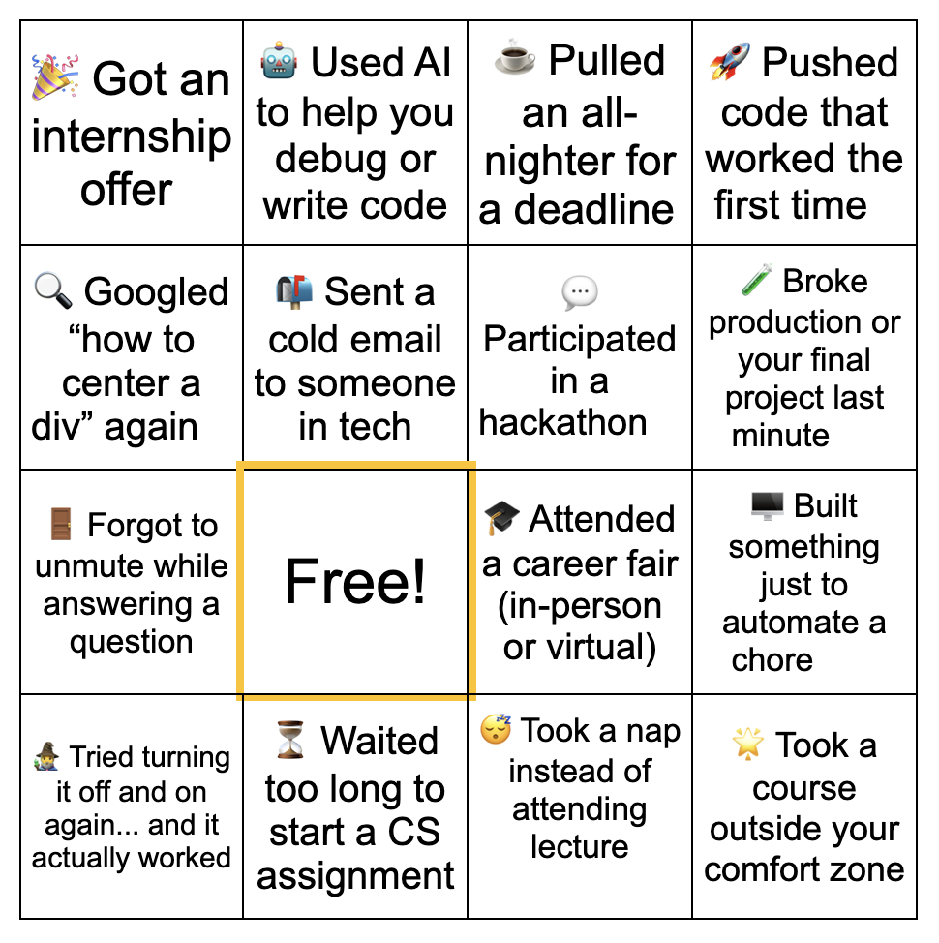
5 minutes

Slide 6
Breakout room instructions not clear enough
More descriptive slides → visuals
Template of UMPIRE → resources tab
Content > intro 👎🏼
Questions lost in chat
Learning UPI of UMPIRE
Live coding
Breakout rooms
Notes:
🌟 Purpose: Share feedback from the previous session and highlight areas of success and improvement.
✅ What should I be doing?
Summarize feedback from the previous session's survey and present key takeaways.
🎙️ What should I be saying?
From your feedback, it seems many of you enjoyed [highlighted aspect]. One suggestion was [area for improvement]. We’ll work on that today.
🙌🏽 How should I engage students?
Ask: "Does anyone have additional feedback or suggestions?"

Slide 7

Announcements & Reminders (3 minutes)
Please watch this Loom with announcements!
🎥 Cameras-on policy to be fully implemented this week!
Expect chat communication from TFM or PM if your camera is off
Moving forward, students who cannot meet this cameras-on expectation will be asked to leave the meeting
🗣️ Communicate absence concerns to support@codepath.org
Do not post about absences in Slack channels please 💚
Expect at most a 48-hour turnaround response from support@
Clarification about standard vs. advanced breakout rooms!
This refers to the problem sets…not pace. Sorry for the miscommunication!

Slide 8

Turn on your cameras!
Notes:
🌟 Purpose: Foster visual engagement to create a more interactive and connected virtual environment.
✅ What should I be doing?
Encourage students to turn on their cameras.
🎙️ What should I be saying?
Let’s all turn on our cameras to make this session more interactive and engaging. Seeing everyone’s faces makes it easier to connect and collaborate!
🙌🏽 How should I engage students?
Acknowledge those who turn on their cameras: "Thanks for turning on your camera, [Student Name]! It’s great to see everyone today."

Slide 9

Choosing Your Breakout Room (1 min)
We’ll share the link to the entry ticket so you can indicate what unit you are on.
We’ll create breakout groups based on the unit you selected.
When it’s Collaborative Problem Solving time, we’ll share the room assignments and demonstrate how to get to your room.
Notes:
🌟 Purpose: Prepare students for collaborative problem-solving time.
✅ What should I be doing?
Explain the breakout room process and answer any logistical questions.
🎙️ What should I be saying?
We’ll use your entry tickets to assign breakout rooms based on your progress in the course. Once assigned, you’ll navigate to your room and start working with your group.

Slide 10
Time Management
10 minutes

Slide 11
3 minutes
Grab a scrap piece of paper or a sticky note!
Write down one short-term goal for this week and one long-term goal for the course.
Notes:
🌟 Purpose: Encourage students to set goals and prioritize their time effectively.
✅ What should I be doing?
Guide students to write down a short-term and long-term goal on paper or a sticky note.
🎙️ What should I be saying?
Grab a sticky note or a piece of paper and write down one goal for this week and one long-term goal for this course. For example, a short-term goal could be 'complete all problems in Unit 2,' and a long-term goal might be 'pass the HackerRank assessments on the first try.
🙌🏽 How should I engage students?
Ask students to hold their goals up to the camera or share them in the chat.

Slide 12
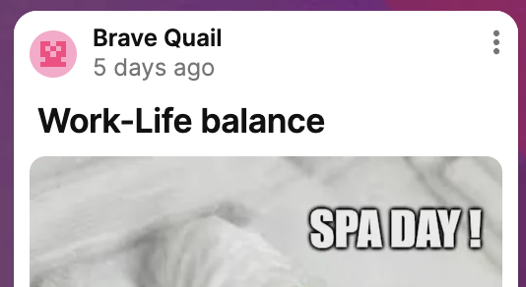
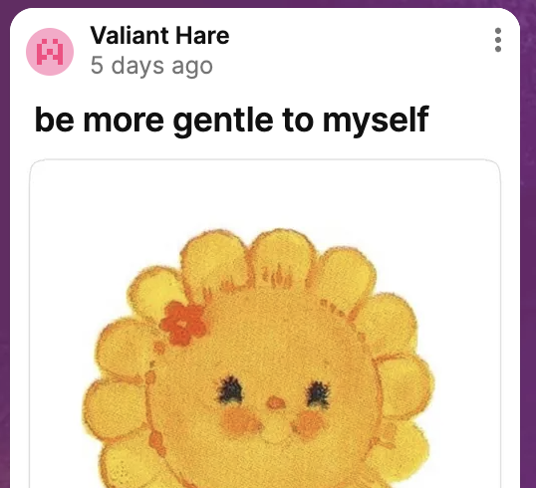
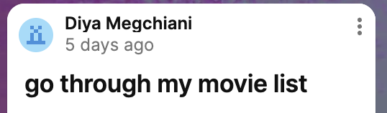
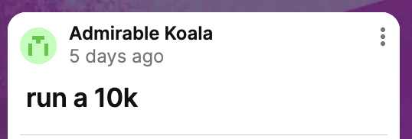
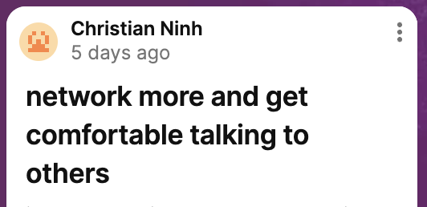
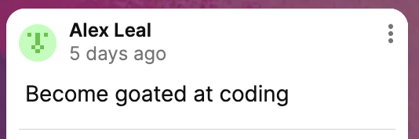
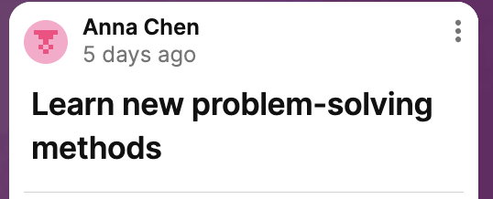
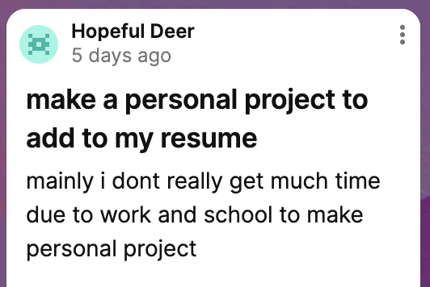
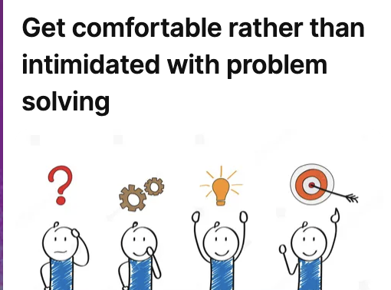
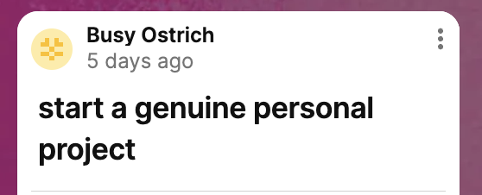
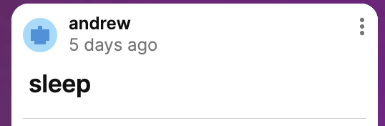
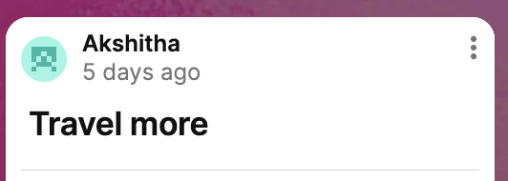
3 minutes
Grab a scrap piece of paper or a sticky note!
Write down one short-term goal for this week and one long-term goal for the course.
Notes:
🌟 Purpose: Encourage students to set goals and prioritize their time effectively.
✅ What should I be doing?
Guide students to write down a short-term and long-term goal on paper or a sticky note.
🎙️ What should I be saying?
Grab a sticky note or a piece of paper and write down one goal for this week and one long-term goal for this course. For example, a short-term goal could be 'complete all problems in Unit 2,' and a long-term goal might be 'pass the HackerRank assessments on the first try.
🙌🏽 How should I engage students?
Ask students to hold their goals up to the camera or share them in the chat.

Slide 13

Balancing Study with Other Commitments
Identify non-negotiables (e.g., work, family) and fit study time around them.
Be realistic about what you can accomplish!
Notes:
🌟 Purpose: Help students recognize and manage external commitments while maintaining consistency.
✅ What should I be doing?
Share practical strategies for balancing commitments and studying.
🎙️ What should I be saying?
We all have responsibilities outside this course, whether it’s work, family, or other activities. The key is to create a realistic schedule. Identify your non-negotiables and plan your study time around them.
🙌🏽 How should I engage students?
Share your own challenges and strategies to make it relatable. Then ask: "What’s one way you’ve managed to stay consistent in your learning?"

Slide 14
3 minutes
In the chat . . .
What challenges do you face in balancing study with other commitments?
How do you plan to overcome them?
Notes:
🌟 Purpose: Create a space for students to share their challenges and solutions for balancing commitments.
✅ What should I be doing?
Facilitate a discussion in the chat or use a Zoom poll.
🎙️ What should I be saying?
"What challenges do you face in balancing study with other commitments? How do you plan to overcome them? Share your thoughts in the chat or unmute to share.
🙌🏽 How should I engage students?
Acknowledge responses and thank students for sharing. If using a poll, discuss the results and common themes.

Slide 15
Dictionaries
25 minutes

Slide 16
3 minutes
What do we know about dictionaries?
Notes:
🌟 Purpose: Assess students' prior knowledge and build a foundation for the lesson.
✅ What should I be doing?
Facilitate an open discussion to gauge familiarity with dictionaries.
🎙️ What should I be saying?
Let’s brainstorm: What do we already know about dictionaries in Python? For example, how are they different from lists or sets?
🙌🏽 How should I engage students?
Prompt students with examples: "A dictionary is like a phonebook with names as keys and numbers as values. Can you think of other examples?"

Slide 17
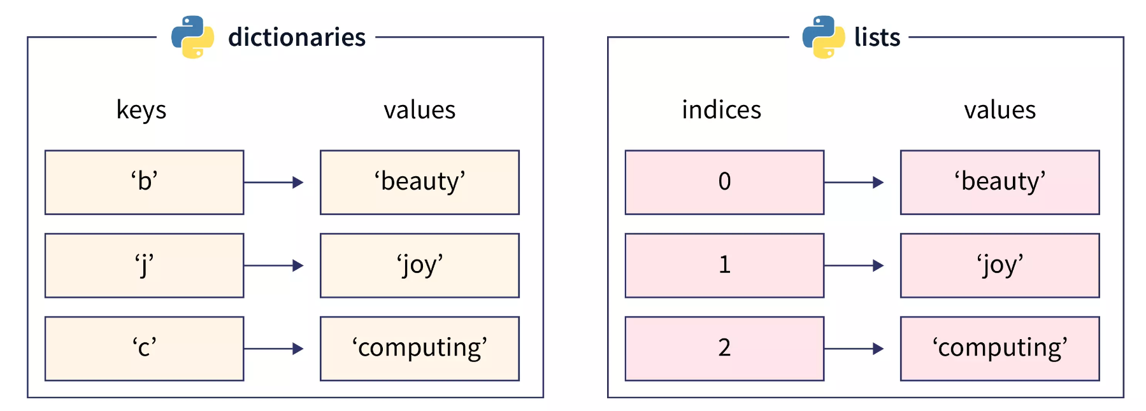
Dictionaries
Key-value pairs for fast lookups.
Use cases: Efficient retrieval and updating of data by unique keys.
Notes:
🌟 Purpose: Introduce dictionaries as a data structure for efficient data retrieval.
✅ What should I be doing?
Explain the concept of key-value pairs and their use cases.
🎙️ What should I be saying?
A dictionary is a collection of key-value pairs where each key is unique. This makes it perfect for tasks like looking up user data or creating frequency maps.
For example, if we’re counting the frequency of words in a sentence, a dictionary can map each word to its count.
🙌🏽 How should I engage students?
Ask: "What are some scenarios where you might use a dictionary in a program?"

Slide 18
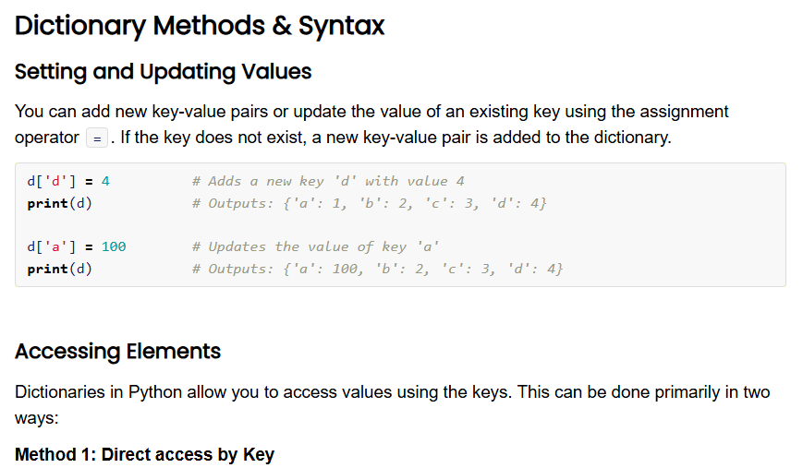
5 minutes
Open the Unit 2 Cheat Sheet and find Dictionary Methods & Syntax. Take a moment to review the functions and examples.
What do you notice?
What do you wonder?
Notes:
🌟 Purpose: Familiarize students with dictionary methods and syntax.
✅ What should I be doing?
Guide students through exploring the cheat sheet and answering questions.
🎙️ What should I be saying?
Take a look at the Dictionary Methods & Syntax section in the Unit 2 Cheat Sheet. What do you notice? What do you wonder?
🙌🏽 How should I engage students?
Invite students to share their observations and clarify any misconceptions.

Slide 19
Common Use Cases
Frequency maps: Counting the frequency of characters in a string or elements in a list
Key-value data storage: Storing data for quick lookups, like a phone book or user settings
Notes:
🌟 Purpose: Highlight practical applications of dictionaries.
✅ What should I be doing?
Provide examples of real-world scenarios where dictionaries are essential.
🎙️ What should I be saying?
Dictionaries are incredibly versatile. You can use them to count character frequencies, store configurations, or even implement simple caching systems.
🙌🏽 How should I engage students?
Ask: "Can you think of a problem you’ve solved or could solve using a dictionary?"

Slide 20

Storing Elements in a Dictionary
Useful if you need to group or join data together across some common attribute
Examples
Find duplicates in a given array
Determine whether all elements in an array have a unique number of occurrences
Approach
Declare a dictionary
Add the element to the collection if it doesn’t exist; otherwise, update the value of the collection at the element’s key

Slide 21
Pros and Cons
O(1) lookup👍🏼
Counting frequency 👍🏼
Flexible type mapping 👍🏼
Extra space 👎🏼
Hash collisions 👎🏼
Unordered (in some languages) 👎🏼
Python 3.7+ 👌🏼
→ Some problems let you pick the data structure to solve the problem, while others give you a specific structure (like a binary tree) and ask you to work with it.

Slide 22

Traffic Lights
GREEN — Keep going! YELLOW — Proceed Slowly RED — Stop!

Slide 23
Storing Elements in a HashMap Example
Given an array of positive numbers, find the value with the greatest number of occurrences.
HashMap
(elem -> occurrences)
2 | 1 | 5 | 1 | 3 | 1

Slide 24
Storing Elements in a HashMap Example
Given an array of positive numbers, find the value with the greatest number of occurrences.
HashMap
(elem -> occurrences)
2 -> 1
2 | 1 | 5 | 1 | 3 | 1
Add to HashMap with default value 1 (for first occurrence)

Slide 25
Storing Elements in a HashMap Example
Given an array of positive numbers, find the value with the greatest number of occurrences.
HashMap
(elem -> occurrences)
2 -> 1
1 -> 1
2 | 1 | 5 | 1 | 3 | 1
Add to HashMap with default value 1 (for first occurrence)

Slide 26
Storing Elements in a HashMap Example
Given an array of positive numbers, find the value with the greatest number of occurrences.
HashMap
(elem -> occurrences)
2 -> 1
1 -> 1
5 -> 1
2 | 1 | 5 | 1 | 3 | 1
Add to HashMap with default value 1 (for first occurrence)

Slide 27
Storing Elements in a HashMap Example
Given an array of positive numbers, find the value with the greatest number of occurrences.
HashMap
(elem -> occurrences)
2 -> 1
1 -> 2
5 -> 1
2 | 1 | 5 | 1 | 3 | 1
Key exists, so increment number of occurrences

Slide 28
Storing Elements in a HashMap Example
Given an array of positive numbers, find the value with the greatest number of occurrences.
HashMap
(elem -> occurrences)
2 -> 1
1 -> 2
5 -> 1
3 -> 1
2 | 1 | 5 | 1 | 3 | 1
Add to HashMap with default value 1 (for first occurrence)

Slide 29
Storing Elements in a HashMap Example
Given an array of positive numbers, find the value with the greatest number of occurrences.
HashMap
(elem -> occurrences)
2 -> 1
1 -> 3
5 -> 1
3 -> 1
2 | 1 | 5 | 1 | 3 | 1
Key exists, so increment number of occurrences

Slide 30
Storing Elements in a HashMap Example
Given an array of positive numbers, find the value with the greatest number of occurrences.
HashMap
(elem -> occurrences)
2 -> 1
1 -> 3
5 -> 1
3 -> 1
2 | 1 | 5 | 1 | 3 | 1
The value 1 has the greatest number of occurrences.

Slide 31
Traffic Lights
GREEN — Keep going! YELLOW — Proceed Slowly RED — Stop!

Slide 32
UPI Recap
UNDERSTAND
IMPLEMENT
REVIEW
MATCH
PLAN
EVALUATE
Notes:
🌟 Purpose: Reinforce the importance of the UMPIRE strategy for problem-solving.
✅ What should I be doing?
Recap the Understand, Plan, and Implement steps.
🎙️ What should I be saying?
Let’s revisit UPI. First, understand the problem requirements. Next, create a clear plan with pseudocode. Finally, implement your solution and test it thoroughly.
🙌🏽 How should I engage students?
Ask: "Which of these steps do you find most challenging, and why?"

Slide 33
5 minutes
Write a function that takes a list of words and returns a dictionary where the keys are the words and the values are the number of times each word appears in the list.
Example Input: words = ['apple', 'banana', 'apple', 'orange', 'banana', 'apple']
Example Output: {'apple': 3, 'banana': 2, 'orange': 1}
Notes:
🌟 Purpose: Demonstrate solving a problem using dictionaries in Python by applying the UPI steps of the UMPIRE strategy (Understand, Plan, Implement). Engage students throughout the demo and normalize mistakes during implementation.
✅ What should I be doing?
Walk through the UPI steps (Understand, Plan, Implement) of the UMPIRE strategy to solve the problem.
Encourage student interaction by asking questions at each step.
Model debugging and error handling by introducing a small mistake intentionally and resolving it collaboratively.
🎙️ What should I be saying?
1. Understand the Problem
"Let’s start with the first step: Understand. Our goal is to [describe the problem, e.g., count the frequency of words in a given sentence and store the results in a dictionary]."
"The input is a string: 'hello world hello'. The expected output is a dictionary with word frequencies: {'hello': 2, 'world': 1}."
"Key constraints include ignoring punctuation and treating words case-insensitively."
"Let’s identify potential edge cases: What happens if the input string is empty? Or if it contains repeated punctuation like 'hello!!!'?"
Ask: "Does everyone understand the problem? Are there any questions about the requirements?"
2. Plan
"Now let’s move to Plan. How can we use a dictionary to solve this efficiently?"
"Here’s the step-by-step approach:
Split the string into individual words using .split().
Iterate through the words, cleaning each one (e.g., removing punctuation and converting to lowercase).
Use a dictionary to track the frequency of each word: if the word exists as a key, increment its value; otherwise, add it with an initial value of 1."
"This plan leverages the O(1) average time complexity of dictionary key lookups for efficiency."
Ask: "Does this plan make sense? What might be a potential challenge when implementing it?"
3. Implement
"Let’s implement our plan step by step in Python. I’ll start by defining the function count_word_frequencies."
Code: def count_word_frequencies(sentence):
word_freq = {}
words = sentence.split()
for word in words:
word = word.lower().strip(".,!?") # Clean the word
if word in word_freq:
word_freq[word] += 1
else:
word_freq[word] = 1
return word_freq
"Notice how we use word.lower() to make the process case-insensitive and .strip() to remove punctuation."
Normalize Mistakes
Intentionally make an error, such as forgetting to initialize the dictionary:
"Oops, I forgot to initialize word_freq. Let’s run the code and see what happens."
Debug: "Ah, it throws a NameError. Why do you think that happened? Let’s fix it by properly initializing word_freq as an empty dictionary."
Re-run the code with corrections and validate the results.
🎙️ How should I engage students?
Ask for predictions: "Before we run the code, what output do you expect for the input 'hello world hello'?"
Encourage questions: "Does anyone see another way to handle punctuation and make this cleaner? What if we used regular expressions?"
Invite suggestions: "What edge cases should we test? For example, what should the function return for an empty string or input with only punctuation?"
Normalize mistakes: "Mistakes are a natural part of coding! Let’s debug this step by step together."

Slide 34
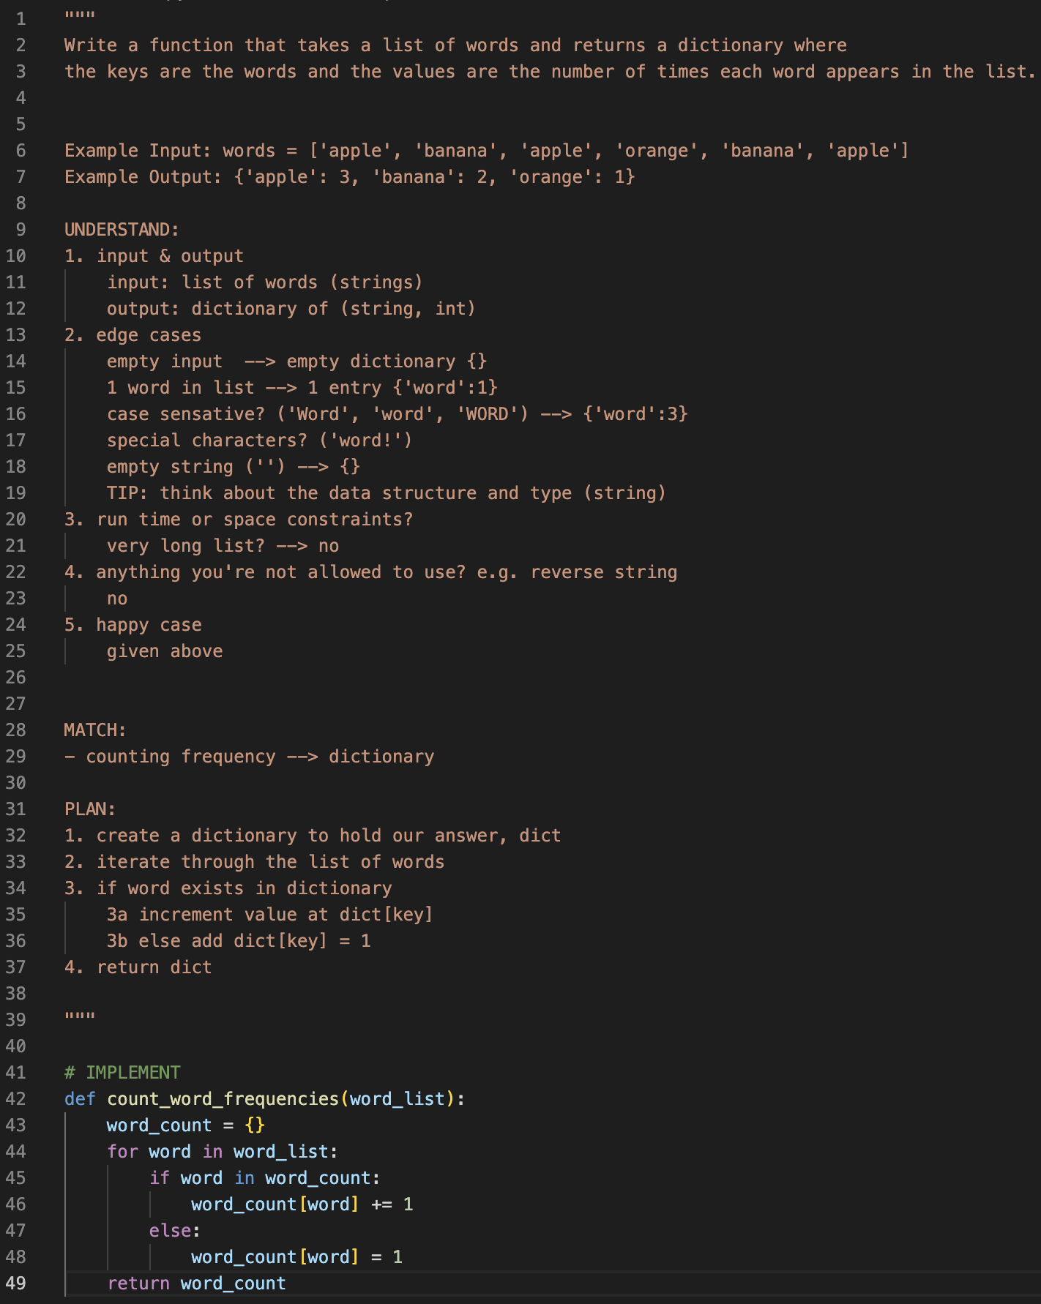

Slide 35
Traffic Lights
GREEN — Keep going! YELLOW — Proceed Slowly RED — Stop!

Slide 36

Break Time!
Take 5 mins to step away from the computer. Feel free to turn off your camera and return promptly after 5 mins.
Notes:
🌟 Purpose: Provide a short break to refresh and re-energize.
✅ What should I be doing?
Announce the break and remind students to return on time.
Play the countdown timer video (be sure to share sound).
🎙️ What should I be saying?
Let’s take 5 minutes to step away from the screen. Be sure to return promptly.

Slide 37
Collaborative Problem Solving
50 minutes

Slide 38
Choosing Your Breakout Room
We’ll share the room assignments.
We’ll demonstrate how to find your room assignment and navigate to your room.
Notes:
🌟 Purpose: Smoothly transition students into breakout rooms for collaboration.
✅ What should I be doing?
Share room assignments and explain how to join breakout rooms.
🎙️ What should I be saying?
Use the link to find your room and introduce yourself to your group.
🙌🏽 How should I engage students?
Check that everyone understands the process before sending them to breakout rooms.

Slide 39
50 minutes
🏃🏽 Navigate to your breakout room.
👋🏽 Introduce yourselves!
🧑🏽‍💻 Work on the problems for your selected unit.
Live share option

Slide 40
Wrap Up
10 minutes

Slide 41
AI Checkpoint #1
5 minutes

Slide 42




2-3 minutes
What roles can AI play in your learning?
Virtual TA
What else?
Debugging Partner
Research Assistant
Notes:
AI usage can vary by course, so this can get students thinking about how to use it in this class specifically

Slide 43
2-3 minutes
What’s the easiest mistake to make when using AI?
What’s the best tip you know on how to make better use of AI?
Notes:
Ask students to share out AI tricks they’ve learned with their peers
Did the AI offer a solution that worked right away, or did it require iteration or clarification? If so, what clarifications and additional context did you provide?
How did you balance using AI assistance with trying to solve problems independently? How did it compare to your experiences debugging without AI?

Slide 44


How to Use AI in this Course
Green Flags
Red Flags
Use AI to…
When using AI, don’t…
Clarify unfamiliar terms
Explain code concepts
Check your code for errors
Brainstorm ideas for your code
Trust it blindly
Use AI-provided code without understanding it
Ignore best practices
Replace your own decision-making

Slide 45
Notes:
🌟 Purpose: End the session on a positive note.
✅ What should I be doing?
Prompt students to share their reflections in the chat.
🎙️ What should I be saying?
Let’s celebrate your wins. Share one good thing you learned or accomplished today!
🙌🏽 How should I engage students?
Read a few responses aloud and celebrate with enthusiasm.

Slide 46


Session Survey Time!
Notes:
🌟 Purpose: Gather feedback to improve future sessions.
✅ What should I be doing?
Share the survey link and emphasize its importance.
🎙️ What should I be saying?
Your feedback helps us make these sessions even better. Please take a moment to complete the survey.
🙌🏽 How should I engage students?
Thank students for their input and explain how feedback has been used in the past.

Slide 47

Final Reminders
Finish the problem sets for additional practice
Take the weekly HackerRank assessment by Sunday @ midnight
Notes:
🌟 Purpose: Reinforce key tasks and deadlines.
✅ What should I be doing?
Summarize next steps and encourage continued engagement.
🎙️ What should I be saying?
Don’t forget to complete the problem sets and take the HackerRank assessment by Sunday!
🙌🏽 How should I engage students?
Encourage students to ask any lingering questions before signing off.

